Slide 1
PRESENTATIONApp Quiz
2022-QUIZ-APP-G12

Slide 2
M
E
M
B
E
R
KIM HAK
BIN TIM
ROMY ULVY

Slide 3
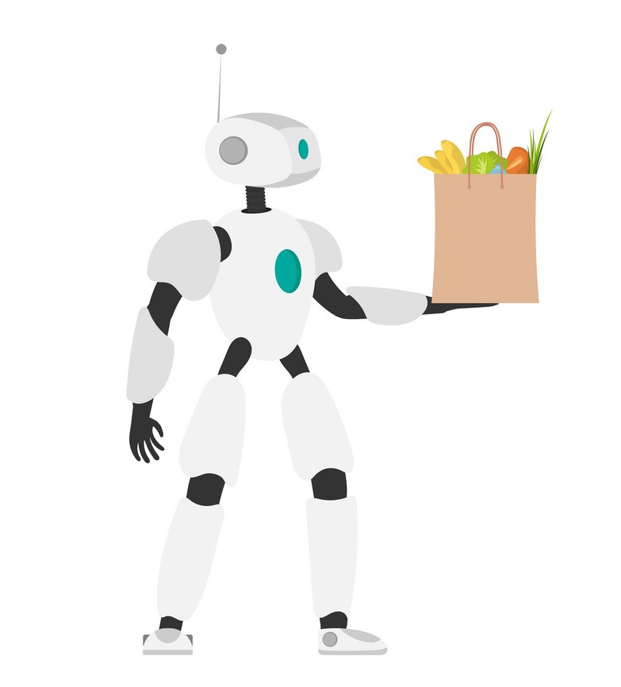
THE SELLER
Demo application
Features in details
KIM HAK

Slide 4
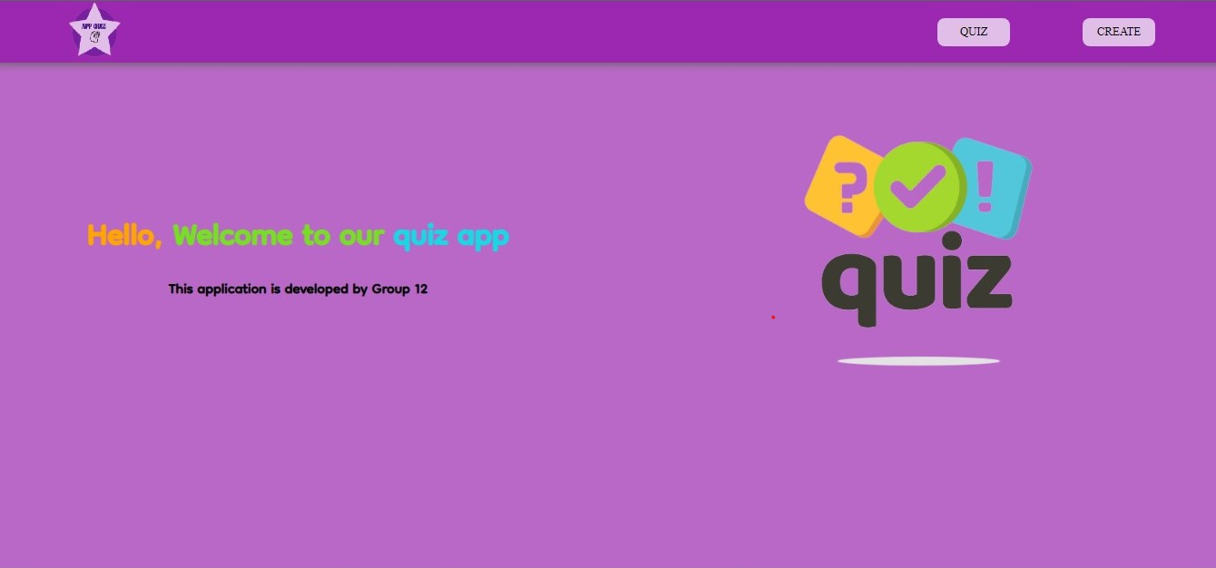
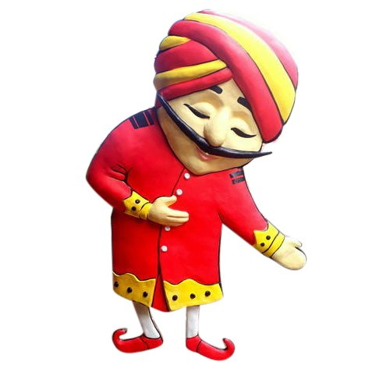
WELCOME

Slide 5

THE TECH
The data structure
The algorithms
The different steps
BIN TIM

Slide 6
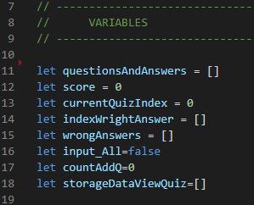
The data structure
Use Array of dictionary for store data
Set data to local storage
Get data from data local storage
Display question from local storage

Slide 7
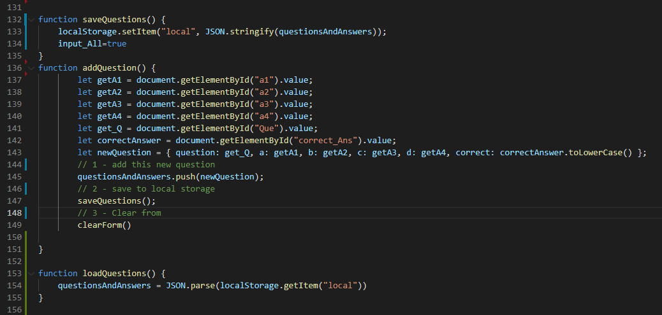

Slide 8
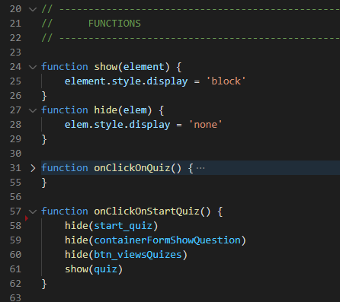
The algorithms
Show and hide
Delete question from local storage and temporary storage
Reload question and answers
Check answers and compute score

Slide 9
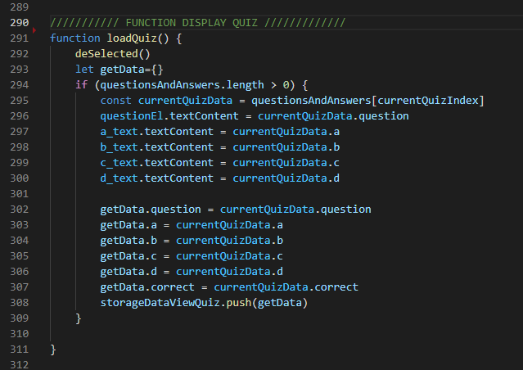

Slide 10
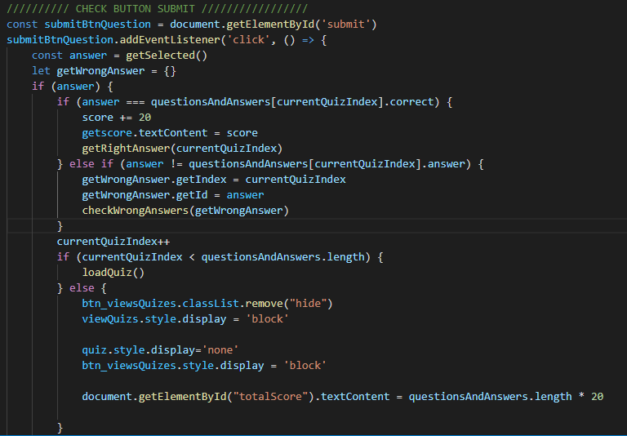

Slide 11
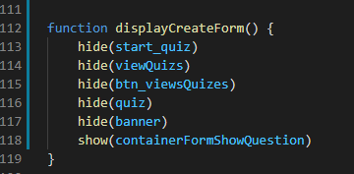
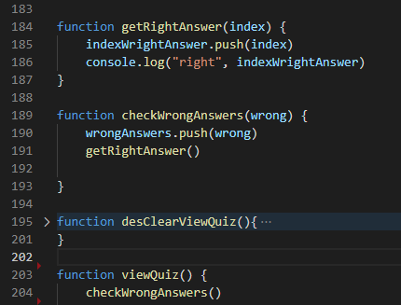
The different steps
Create form input
Plays quiz
View quiz

Slide 12

THE MANAGER
Team work together
Team achievements
Team need to improve
UlVY ROMY

Slide 13
Q & A

Slide 14





Thank you !
www.passerellesnumeriques.org

